Slide 1

Diet Planner Based on BMI
Megh Patel [AU2544020]
Konark Karia [AU2544011]
Notes:
Good morning/afternoon everyone, we’re Megh Patel and Konark Karia.
Today, we’ll be presenting our project titled “Diet Planner Based on BMI.”
Our project focuses on using Artificial Intelligence to recommend personalized diet plans for individuals based on their BMI and other health factors.

Slide 2
Project Introduction
Our project aims to create an AI-powered diet recommendation system that suggests a suitable diet plan for individuals based on their BMI, health condition, and lifestyle.
The idea is to help people maintain a healthy lifestyle by providing personalized diet advice.
We used a dataset containing details like age, weight, height, diseases, cholesterol, and physical activity to train a machine learning model.
Based on this data, the system recommends the number of calories one should take, depending on a person’s health status.
This makes it easier for users to choose the right food plan that matches their body needs and supports better health management.
Megh Patel & Konark Karia Diet Planner Based on BMI

Slide 3
Literature Review
“Diet Recommendation System Using Machine Learning”
[Reema Golagana, V. Sravani, T. Mohan Reddy][2023]
The paper presents a smart system that suggests personalized diet plans using algorithms like Random Forest, K-Means, and LSTM.
It considers a person’s details such as age, BMI, and food preferences to create healthy meal suggestions using data from the USDA nutrition database.
The results showed that the LSTM model gave more accurate diet recommendations, making it better for creating customized meal plans.
Megh Patel & Konark Karia Diet Planner Based on BMI

Slide 4
Literature Review
“Artificial Intelligence and Machine Learning Technologies for Personalized Nutrition: A Review”
[Dimitris Tsolakidis, Lazaros P. Gymnopoulos, Kosmas Dimitropoulos][2024]
The paper talks about how Artificial Intelligence (AI) and Machine Learning (ML) are used to create personalized diet and nutrition plans for people.
It reviews 67 studies (from 2021–2024) that use smart apps, sensors, and devices to collect health data and give customized food suggestions.
The study shows that AI-based diet systems can help people eat healthier but also mentions there are still challenges to improve accuracy and data privacy.
Megh Patel & Konark Karia Diet Planner Based on BMI

Slide 5
Gaps Identified
Lack of Personalization: Most diet plans available online are general and do not consider a person’s unique body type, BMI, or health condition.
Limited Awareness: Many people are unaware of how their health parameters (like glucose or cholesterol levels) affect their diet choices.
Missing Use of AI: There are very limited number of AI-based systems that automatically analyze health data and give personalized diet recommendations.
Megh Patel & Konark Karia Diet Planner Based on BMI

Slide 6
Methodology Data Preparation & Preprocessing
Dataset Collection & Loading:
Imported the Diet Recommendations Dataset containing weight, height, disease type, age, gender, and activity level.
Data Cleaning:
Handled missing values using SimpleImputer (median for numeric, most frequent for categorical).
Removed inconsistencies and standardized feature naming.
Feature Engineering & Selection:
Identified input features:
Weight, Height, Age, Disease Type, Gender, Physical Activity Level
Extracted target variable: Caloric Requirement.
Separated numerical & categorical features for preprocessing.
Megh Patel & Konark Karia Diet Planner Based on BMI

Slide 7
Methodology Model Development & Training
Preprocessing Pipelines:
Numerical Pipeline: Scaling + Median imputation
Categorical Pipeline: One-Hot Encoding + Mode imputation
Combined using ColumnTransformer.
Model Selection:
Chose Random Forest Regressor due to:
High accuracy for non-linear relationships
Robustness against outliers
Performs well with mixed data types
Model Training:
Applied Train-Test Split (80/20)
Trained model inside a unified Scikit-Learn Pipeline.
Evaluated using:
MAE [Mean Absolute Error]
RMSE [Root Mean Squared Error]
R² Score [Coefficient of Determination]
Megh Patel & Konark Karia Diet Planner Based on BMI

Slide 8
Methodology System Deployment & User Interface
Model Saving:
Exported trained model using Joblib (diet_pipeline.pkl).
Gradio Web Application:
Built a user-friendly interface using Gradio.
Inputs:
Weight, Height, Age, Gender, Disease Type, Activity Level.
Output:
Predicted Daily Calorie Requirement
Calculated BMI
Personalized Health Tips
Final Deployment:
Included feature importance visualization for transparency.
Megh Patel & Konark Karia Diet Planner Based on BMI

Slide 9
RMSE, MAE & R2 Score
Matrix | Training Value
MAE | 515.485
RMSE | 603.327
R2 Score | -0.103
Megh Patel & Konark Karia Diet Planner Based on BMI

Slide 10
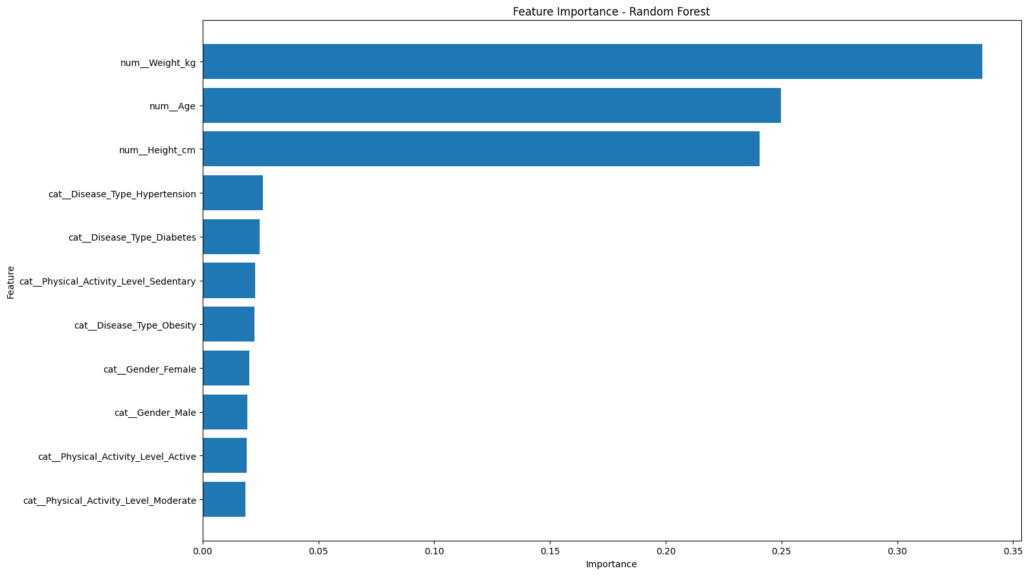
Feature Importance Graph
Megh Patel & Konark Karia Diet Planner Based on BMI

Slide 11
Technical Challenges
Building a preprocessing pipeline that could impute missing values, scale numeric data, and one-hot encode categories correctly — without data leakage — required careful engineering using ColumnTransformer and Pipeline.
To identify the most important features that have the greatest impact on the predicted calorie value.
Megh Patel & Konark Karia Diet Planner Based on BMI

Slide 12
Thank You

